Slide 1
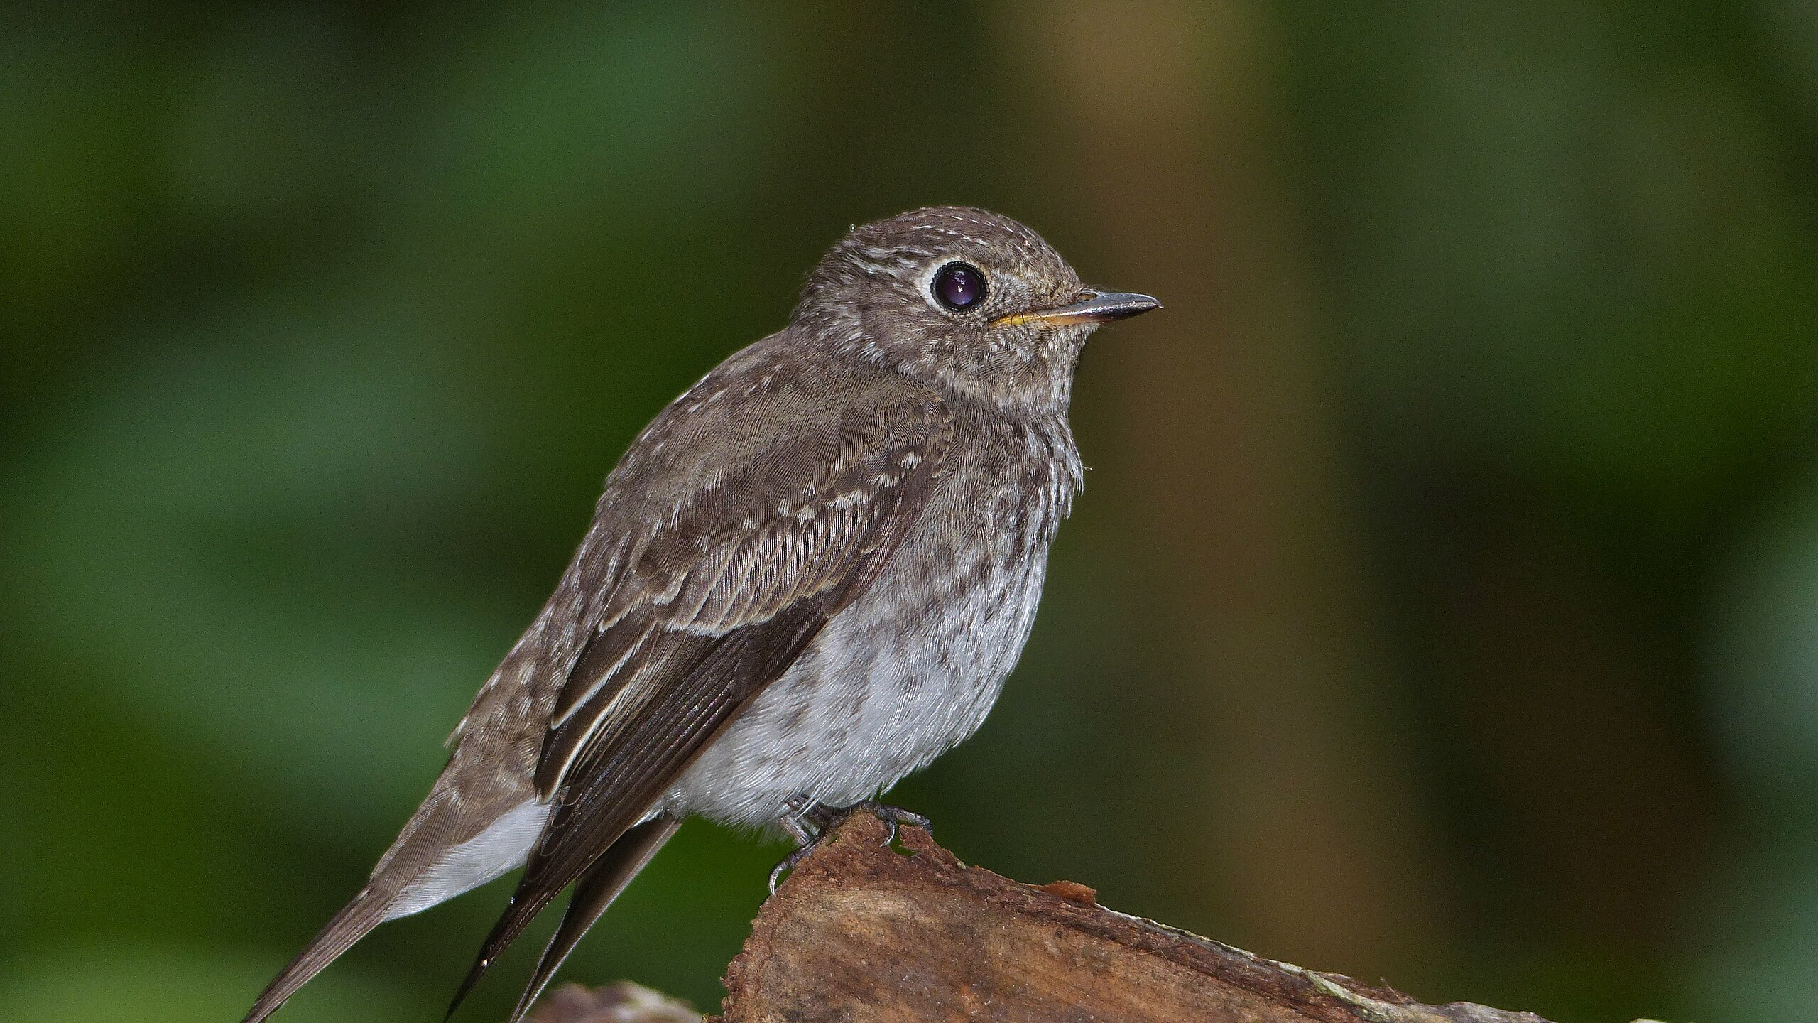
Automated Bird Species Classification
BirdCLEF 2024 Research Project
Using EfficientNetV2 & JAX Backend
Presented by: Wellermen

Slide 2

Identifying Biodiversity through Sound
The Mission: Protecting ecosystem health by monitoring bird populations in India.
The Motivation: Birds are "indicator species"; their presence or absence tells us if an environment is healthy or failing.
The Problem: Manual observation is impossible in dense tropical forests or over long periods.
The Objective: To develop an automated, scalable AI system that can listen to the forest and identify species as accurately as a human expert.

Slide 3
Previous Solutions & Context
 | Traditional Methods: Manual audio observation by experts | Early Digital Methods: Basic Signal Processing (Template Matching). | Standard CNNs: Older models like ResNet or VGG
Pros: | High accuracy. | Fast, no "training" needed. | Good image recognition.
Cons: | Not scalable, expensive, and limited by human presence. | Fails in noisy environments or with variable bird calls. | High computational cost (heavy) and slower inference on mobile/field devices.

Slide 4
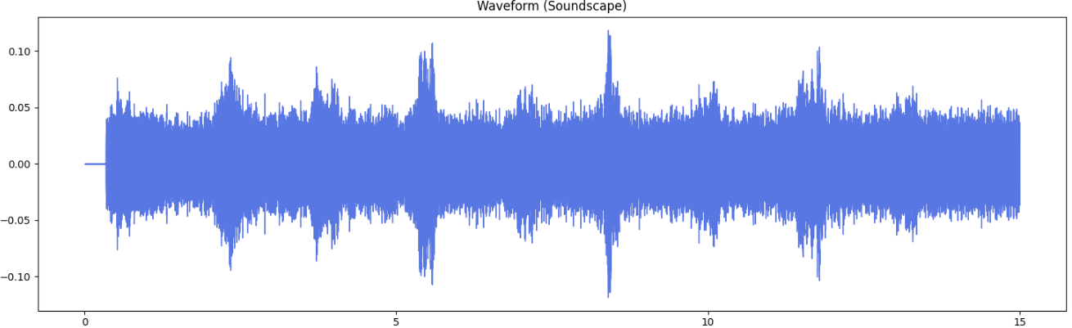
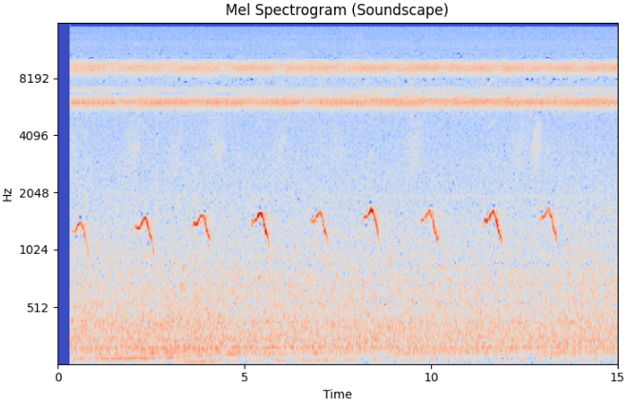
From Waves to Visual Patterns
The Database: 24,459 audio recordings in .ogg format, covering 182 Indian bird species.
The System Plan: A modular pipeline that transforms raw noise into structured visual data.
Preprocessing: Audio is standardized to 15-second segments at a 32,000 Hz sample rate.
Feature Extraction: Conversion of 1D waveforms into 2D Mel-Spectrograms (size 128 x 384).

Slide 5
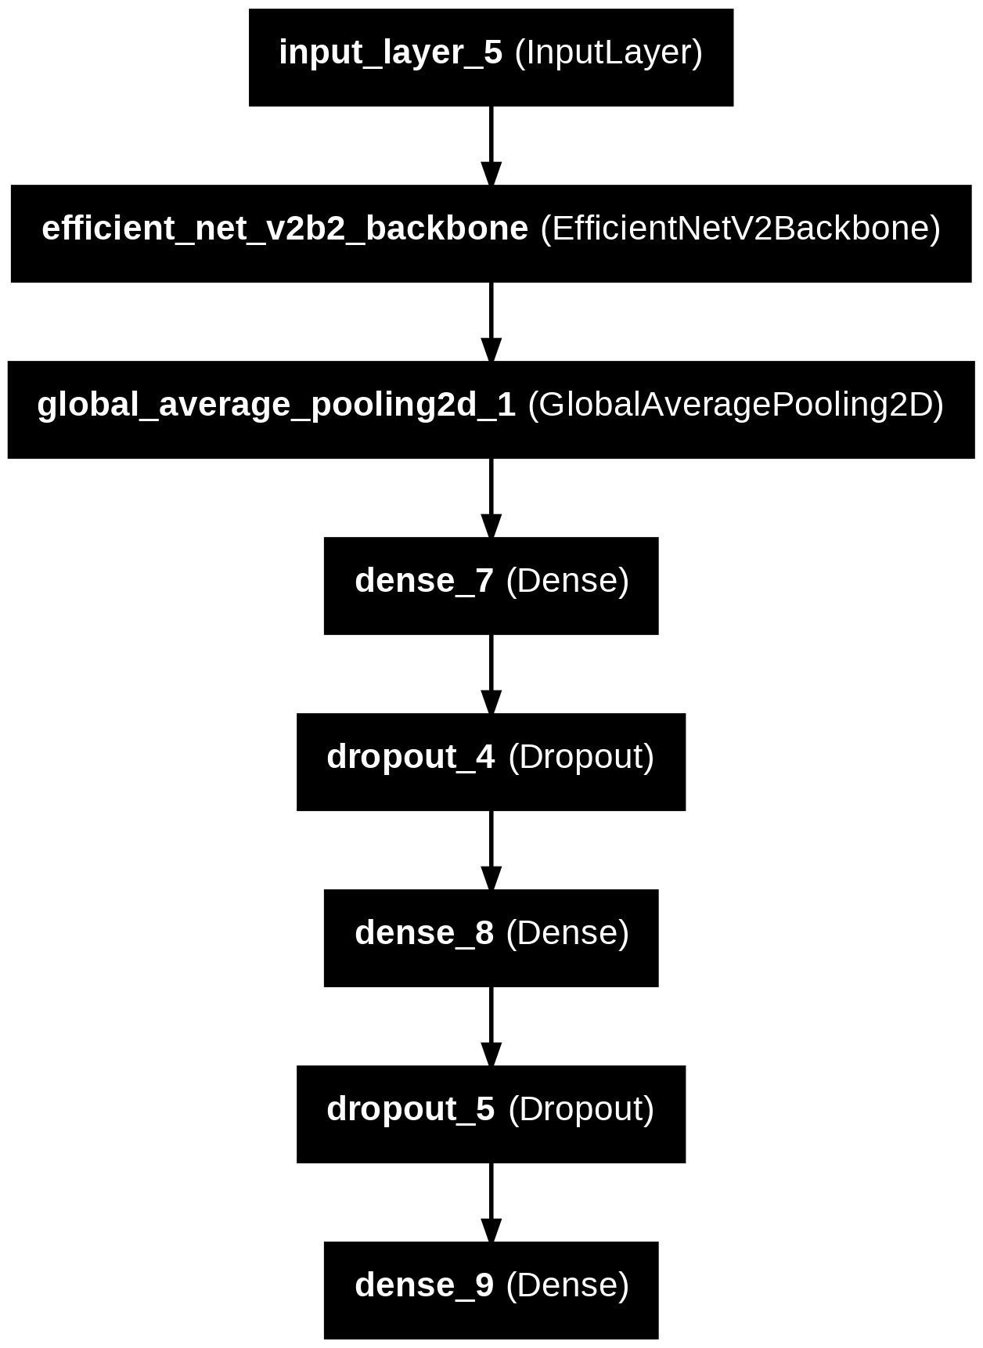


Model Architecture & Framework
Architecture: EfficientNetV2-B2 backbone with ImageNet-1k pre-trained weights.
The Framework: Keras 3 + JAX backend for optimised GPU performance and faster iteration.
Training Specs: 5 epochs, batch size of 16, and categorical cross-entropy loss.
Difficulties & Solutions:
Challenge: Extreme background noise (wind/rain). Solution: Mel-spectrogram scaling and normalisation.
Challenge: Data Imbalance (some birds are rare). Solution: Transfer learning from ImageNet to provide a strong feature-detection baseline.

Slide 6
Results & Evaluation
The Metric: Since the competition is highly imbalanced, we look at Macro F1-Score as the ideal measure for future success.
Hardware Constraints: Training was conducted on Google Colab (Tesla T4 GPU). Given the 182 species and 24k+ files, full convergence requires significant compute time.
Current Focus: The project currently focuses on Pipeline Integrity—ensuring that audio correctly flows through the JAX-optimized preprocessing to the EfficientNet backbone.

Slide 7
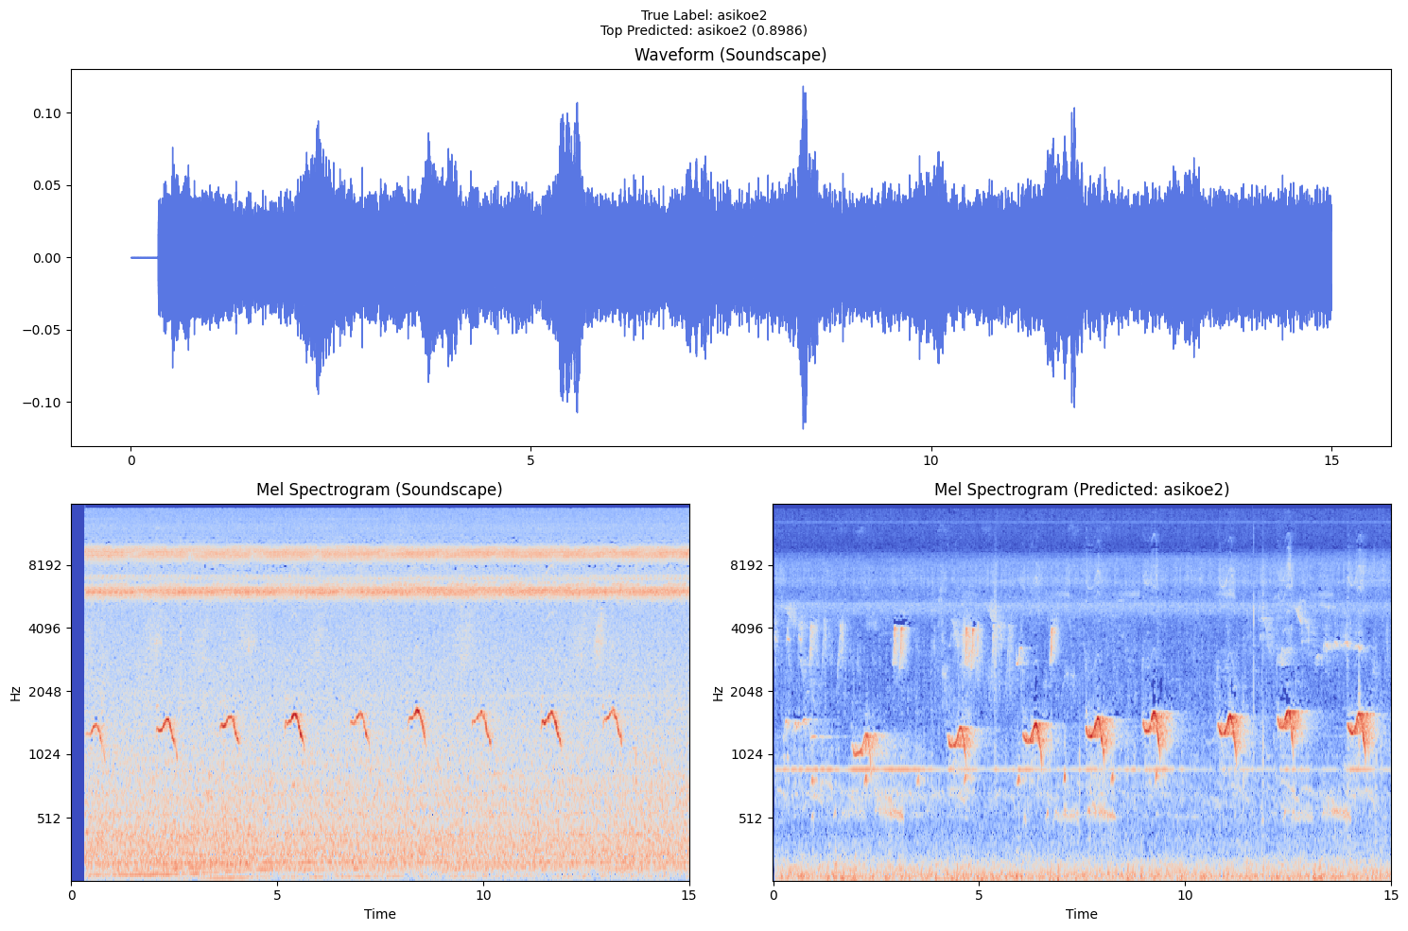
DEMO
Successful audio-to-spectrogram transformation.
End-to-end connectivity: Data → Preprocessing → Model.
Interactive data exploration using Librosa.

Slide 8
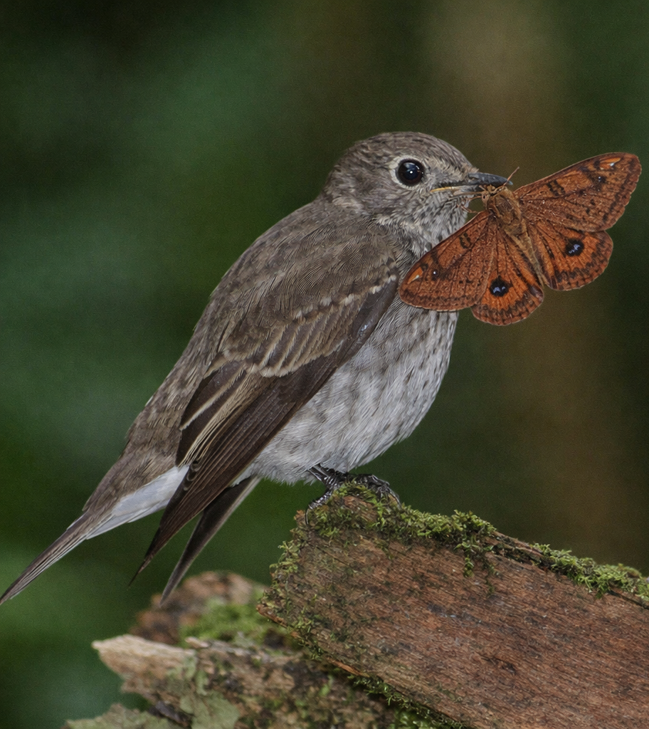
Project Conclusion
Successful Integration: Developed a functional end-to-end pipeline using Keras 3 + JAX stack.
Scalable Design: The move from 1D audio to 2D Mel-spectrograms allows for the use of powerful computer vision backbones like EfficientNetV2.
Future-Ready: While limited by current compute resources, the system is architecturally ready for full-scale biodiversity monitoring.
AI-generated image

